Slide 1
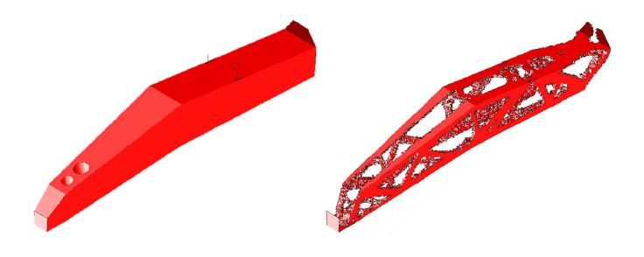
CONDENSATION BASED FINITE ELEMENT MODEL REDUCTION STRATEGY FOR STRUCTURAL OPTIMIZATION PROBLEMS
KAKADE Ishaan
CONIGLIO Simone | MORLIER Joseph

Slide 2
INTRODUCTION

Slide 3

INTRODUCTION
Figure 1: Finite Element Model of Engine an Pylon
Figure 2: Representative Finite Element Model

Slide 4
THE BIG PICTURE

Slide 5
THE BIG PICTURE
During topological optimization processes we use the whole finite element model as our design space (all nodes or degrees of freedom)
We would like to reduce that number to a large extent.
Notes:
Primary Goal: The overall goal of this project is to establish a strategy to reduce the complexity of a finite element problem used for optimization purposes by the use of some (or a combination) of reduction strategies to suppress some degrees of freedom while maintaining the full response.
Secondary Goal: Perhaps an additional goal of the project could be to homogenize the material properties of a structure given that more and more aerospace structures now use composite materials with highly discretized material properties across geometries.

Slide 6
THE BIG PICTURE
Primary Goal: Establish a strategy to reduce the complexity of a finite element problem used for optimization purposes by the use of some (or a combination) of reduction strategies to suppress some degrees of freedom while maintaining the full response – prediction of those degrees of freedom that have been retained.

Slide 7
THE BIG PICTURE
Secondary Goal: Perhaps an additional goal of the project could be to homogenize the material properties of a structure given that more and more aerospace structures now use composite materials with highly discretized material properties across geometries.
L.D. Flippen Jr, (1994), A Theory of Condensation Model Reduction, Computers Math. Application, Vol. 27 (No. 2), pp. 9 - 40.

Slide 8
PROBLEM DEFINITION

Slide 9
PROBLEM DEFINITION
Variable Engine Thickness Architecture
Using Static and Dynamic Condensation Using Varying Techniques
Time Complexity Analysis
Dynamic condensation for Modal Behavior

Slide 10
PROJECT GOALS

Slide 11
PROJECT GOALS
1. Integration of A and I as MMA decision variables (for the complete beam truss and by set i.e. vertical and horizontal beams separately).
2. Implement the classical condensation and a new condensation strategy to reduce the number of degrees of freedom of the non-design zone.
3. Comparison of 3 approaches with respect to time complexity.
4. Implementation of dynamic condensation.

Slide 12
BACKGROUND AND LITERATURE REVIEW

Slide 13
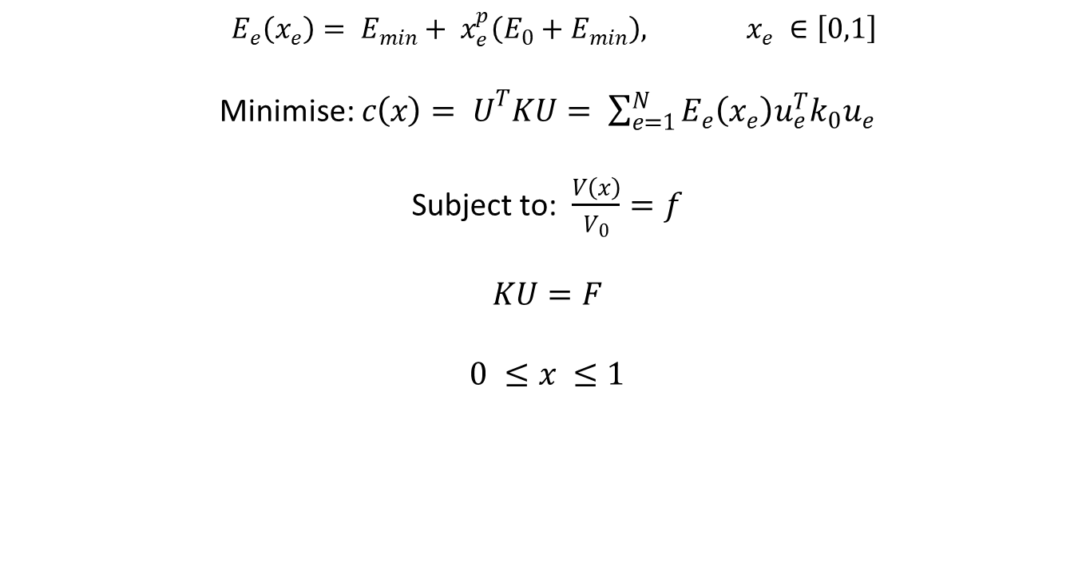
MODIFIED SIMP APPROACH
$${ E}_{e}\left(x_{e}\right)= E_{min}+ x_{e}^{p}\left(E_{0}+E_{min}\right), x_{e} ∈\left[0,1\right]$$
Minimise: $c\left(x\right)= U^{T}KU= \sum_{e=1}^{N}{E_{e}\left(x_{e}\right)u_{e}^{T}k_{0}u_{e}}$
Subject to: $\frac{V\left(x\right)}{V_{0}}=f$
$$KU=F$$
$$0 ≤x ≤1$$
where E₀ is the stiffness of the material, E_{min} is a very small stiffness assigned to void regions in order to prevent the stiffness matrix from becoming singular, and p is penalization factor (typically p = 3) introduced to ensure black-and-white solutions. Equation (1) corresponds to the modified SIMP approach, which differs from the classical SIMP approach used in the original paper in the occurrence of the term E_{min}.

Slide 14
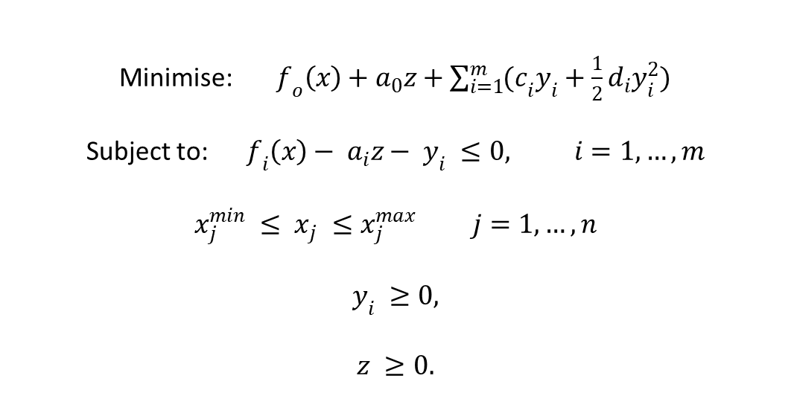
METHOD OF MOVING ASYMPTOTES
Minimise: $f_{o}\left(x\right)+a_{0}z+\sum_{i=1}^{m}{{(c}_{i}y_{i}+\frac{1}{2}d_{i}y_{i}^{2})}$
Subject to: $f_{i}\left(x\right)− a_{i}z− y_{i} ≤0, i=1,…,m$
$$x_{j}^{min} ≤ x_{j} ≤x_{j}^{max} j=1,…, n$$
$$y_{i} ≥0,$$
$$z ≥0.$$
Here, x₁… x_{n} are the “true” optimization variables, while y₁, …, y_{m} and z are “artificial” optimization variables; f₀ f₁… f_{m} are given, continuously differentiable, real-valued functions and constitute the constraint functions evaluated at the current values of the variable x; x_{min} and x_{max} are given real numbers which satisfy x_{min}^{j} < x_{max}^{j}; a₀ and a_{i} are given real numbers which satisfy a₀ > 0 and a_{i} ≥ 0; c_{i} and d_{i} are given real numbers which satisfy c_{i} ≥ 0, d_{i} ≥ 0 and c_{i} + d_{i} > 0.

Slide 15
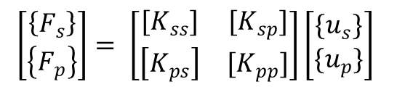

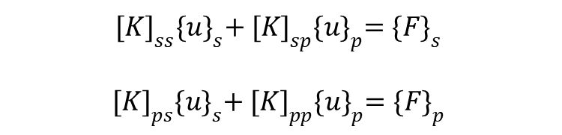
STATIC CONDENSATION
$$\left[\begin{matrix}\left\{F_{s}\right\} \\ \left\{F_{p}\right\}\end{matrix}\right]= \left[\begin{matrix}[K_{ss}] & [K_{sp}] \\ \left[K_{ps}\right] & [K_{pp}]\end{matrix}\right]\left[\begin{matrix}\{u_{s}\} \\ \{u_{p}\}\end{matrix}\right]$$
$${[K]}_{ss}{\{u\}}_{s}+ {[K]}_{sp}{\{u\}}_{p}=\{{F\}}_{s}$$
$${[K]}_{ps}{\{u\}}_{s}+ {[K]}_{pp}{\{u\}}_{p}={\{F\}}_{p}$$
$${\{F′\}}_{p}=[K′]{\{u\}}_{p}$$
Assume that those secondary degrees of freedom to be reduced or condensed are arranged in the first ‘s’ nodal coordinates and the remaining primary degrees of freedom are the last ‘p’ nodal coordinates.
Where K’ and F’ are the condensed stiffness and force vectors and {u}_{p} is the vector of primary displacement

Slide 16
DYNAMIC CONDENSATION
Used to include inertia effects in a condensation model
Essentially, a mass re-distribution
Reduction of the Mass Matrix
Guyan condensation

Slide 17
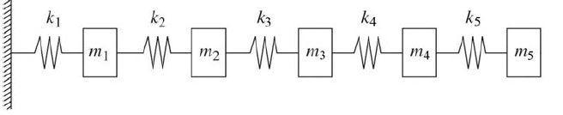
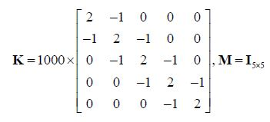
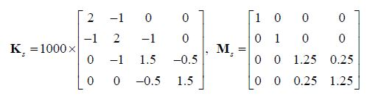
CONDENSATION
Condensation
Figure 3: Spring – Mass System with a certain dynamic and Static Behaviour
Dongsheng Li, Discussion of Model Reduction and Reservation, Procedia Engineering, Volume 188, 2017, Pages 354-361, ISSN 1877-7058,

Slide 18
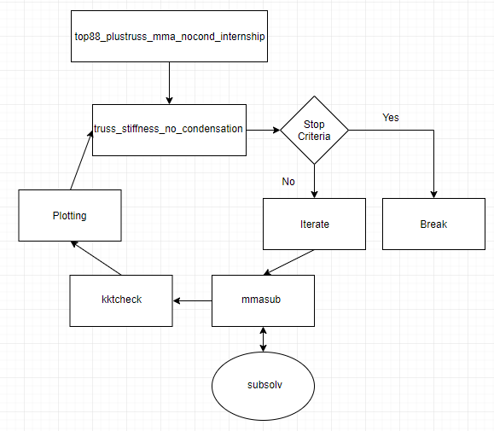
MATLAB IMPLEMENTATION
Figure 4: Function Call Flow Chart on MATLAB

Slide 19
STATE OF WORK

Slide 20
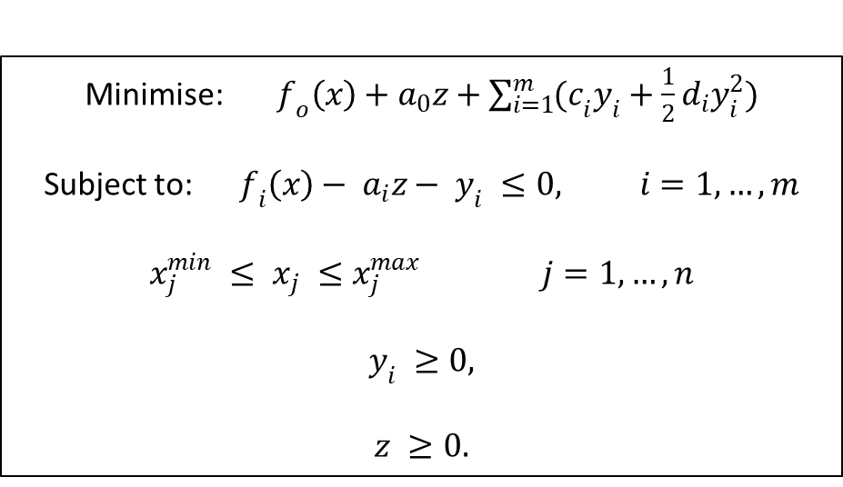
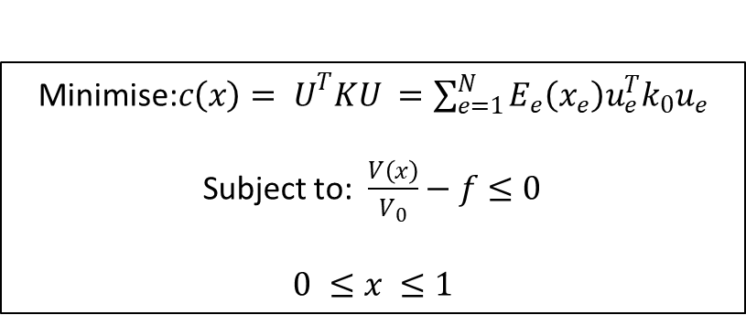
OPTIMIZATION PROBLEM
Minimise: $f_{o}\left(x\right)+a_{0}z+\sum_{i=1}^{m}{{(c}_{i}y_{i}+\frac{1}{2}d_{i}y_{i}^{2})}$
Subject to: $f_{i}\left(x\right)− a_{i}z− y_{i} ≤0, i=1,…,m$
$$x_{j}^{min} ≤ x_{j} ≤x_{j}^{max} j=1,…, n$$
$$y_{i} ≥0,$$
$$z ≥0.$$
Minimise:$c\left(x\right)= U^{T}KU =\sum_{e=1}^{N}{E_{e}\left(x_{e}\right)u_{e}^{T}k_{0}u_{e}}$
Subject to: $\frac{V\left(x\right)}{V_{0}}−f≤0$
$$0 ≤x ≤1$$
Notes:
Where, from the general MMA optimization problem description: a₀ = 1, a_{i} = 0, d_{i} = 0 and c_{i} = “large number”. The reason c_{i} is large is because we force the variable y_{i} to be “expensive” such that generally, y = 0 for any optimal solution for f_{o}.

Slide 21
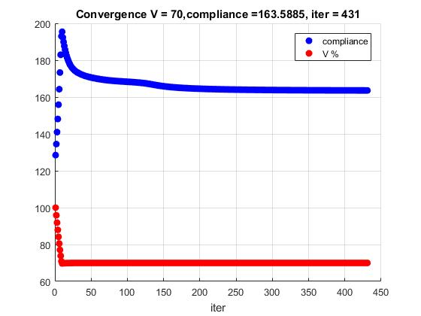
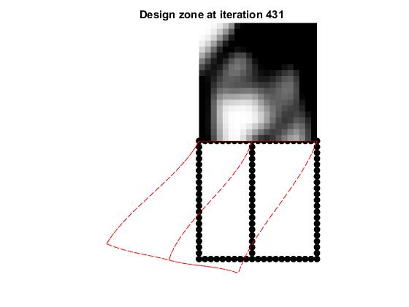
PRELIMINARY RESULTS
Figure 5: Topology output for the design zone with nelx = 20; nely = 20 and no area and inertial dependency and showing displacements in red
Figure 6: Compliance and volume fraction reduction versus iteration number

Slide 22
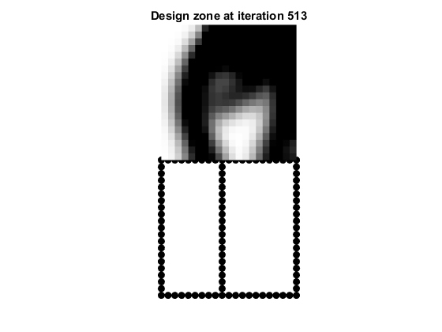
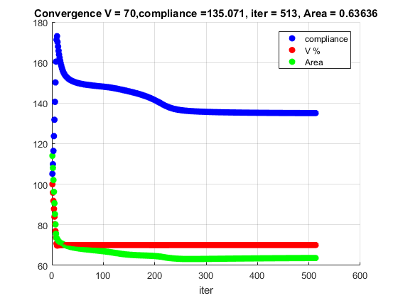
AREA AND INERTIAL INTEGRATION
Figure 7: Topology output for the design zone with nelx = 20; nely = 20 and with area and inertial dependency showing changes in topology output
Figure 8: Compliance, volume fraction and area reduction versus iteration number
We take a region close to the truss such that the ‘density’ of the elements in that region determines the average area of cross-section and inertia values for the following iteration of the generation of the stiffness matrix.

Slide 23
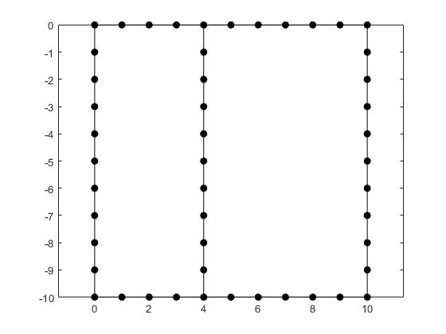
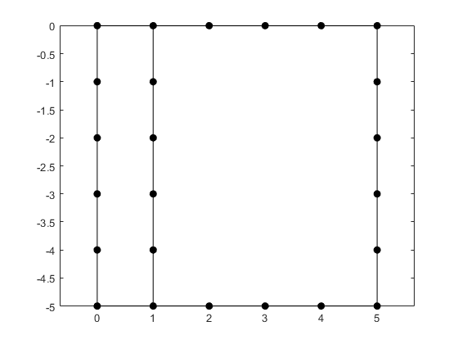
STATIC CONDENSATION
Figure 9: Beam truss before condensation
Figure 10: Beam truss after condensation
The goal is to effectively reduce the number of nodes in the truss members. By relating the displacements of one node to the other, the effective number of nodes in the truss members may be thus reduced

Slide 24
MILESTONES
Literature Review on Condensation(Contd.)
Choice of Condensation Modelling Technique
Implementation of Working Code
Time Complexity Comparison
Testing of Code on Sample Cases

Slide 25
KEY CHALLENGES
Choosing appropriate assumptions for mass distributions in the engine.
Choosing our decision variables carefully so as to not lose out important regions in the structure to optimize.
Building a code that is reasonably fast.
Notes:
1. Choosing appropriate assumptions for mass distributions across the structure in the condensation model to accurately model physics can be a big challenge. If the mass distribution is not appropriately chosen we can get a large variation in the value of natural frequencies and hence dynamic behaviour of structures (20% in some cases [6]).
So, how should we distribute the mass associated with a node to avoid this error?
2. Given that our problem is one on optimization and not condensation, we have to choose our decision variables quite carefully so as to not lose out important regions in the structure to optimize. There mostly exists a trade-off between how well we can condense and how well we can optimize the structure. Which is the minimal number of retained DOFs of beam truss you should keep? Can we improve the classic strategy?
3. The gain in terms of computational cost is quite unclear and may not be as high as one might think if the code has to condense the model every time we run an optimization. Reduction in time complexity of the code remains a mystery. Is our code reasonably fast?

Slide 26
Thank you! Questions/Suggestions?

